Slide 1
I 595 EXPRESS CONTRACTOR’S
AND SUPPLIERS
BREAKFAST FORUM
WELCOME

Slide 2
Juan Miguel Peréz
Executive Vice President
DRAGADOS USA
Alvaro Muelas
Chief Executive Officer
I 595 EXPRESS, LLC

Slide 3

CHECK
PRESENTATION

Slide 4
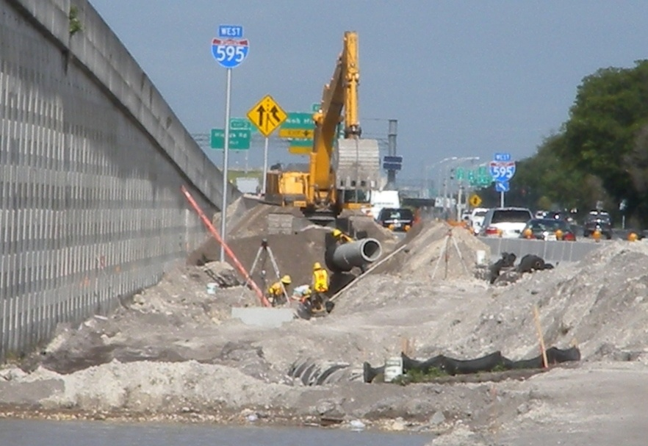

I-595 Express Corridor Improvements Project
Paul Lampley
I-595 Construction Project Manager
District Four, FDOT

Slide 5
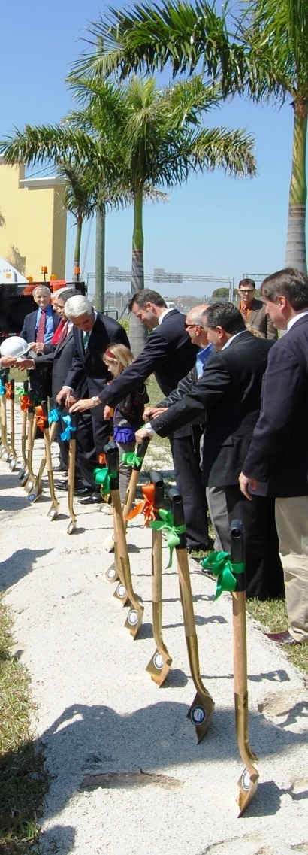
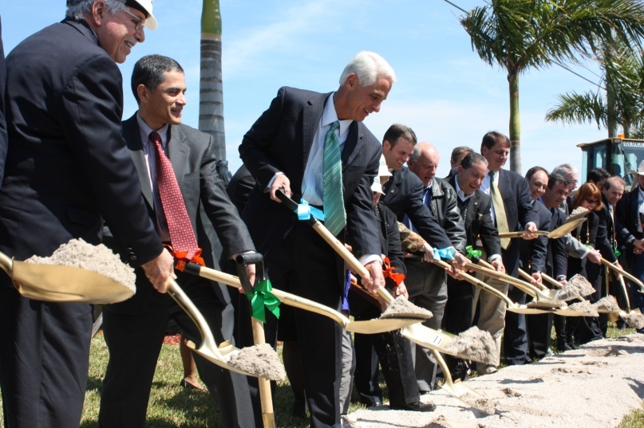
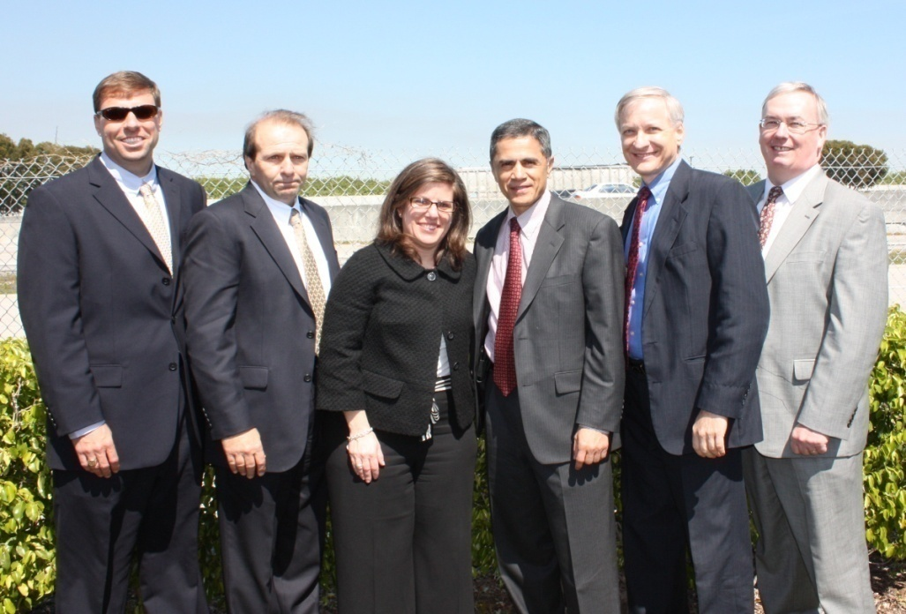
Ceremonial Groundbreaking
February 26, 2010

Slide 6
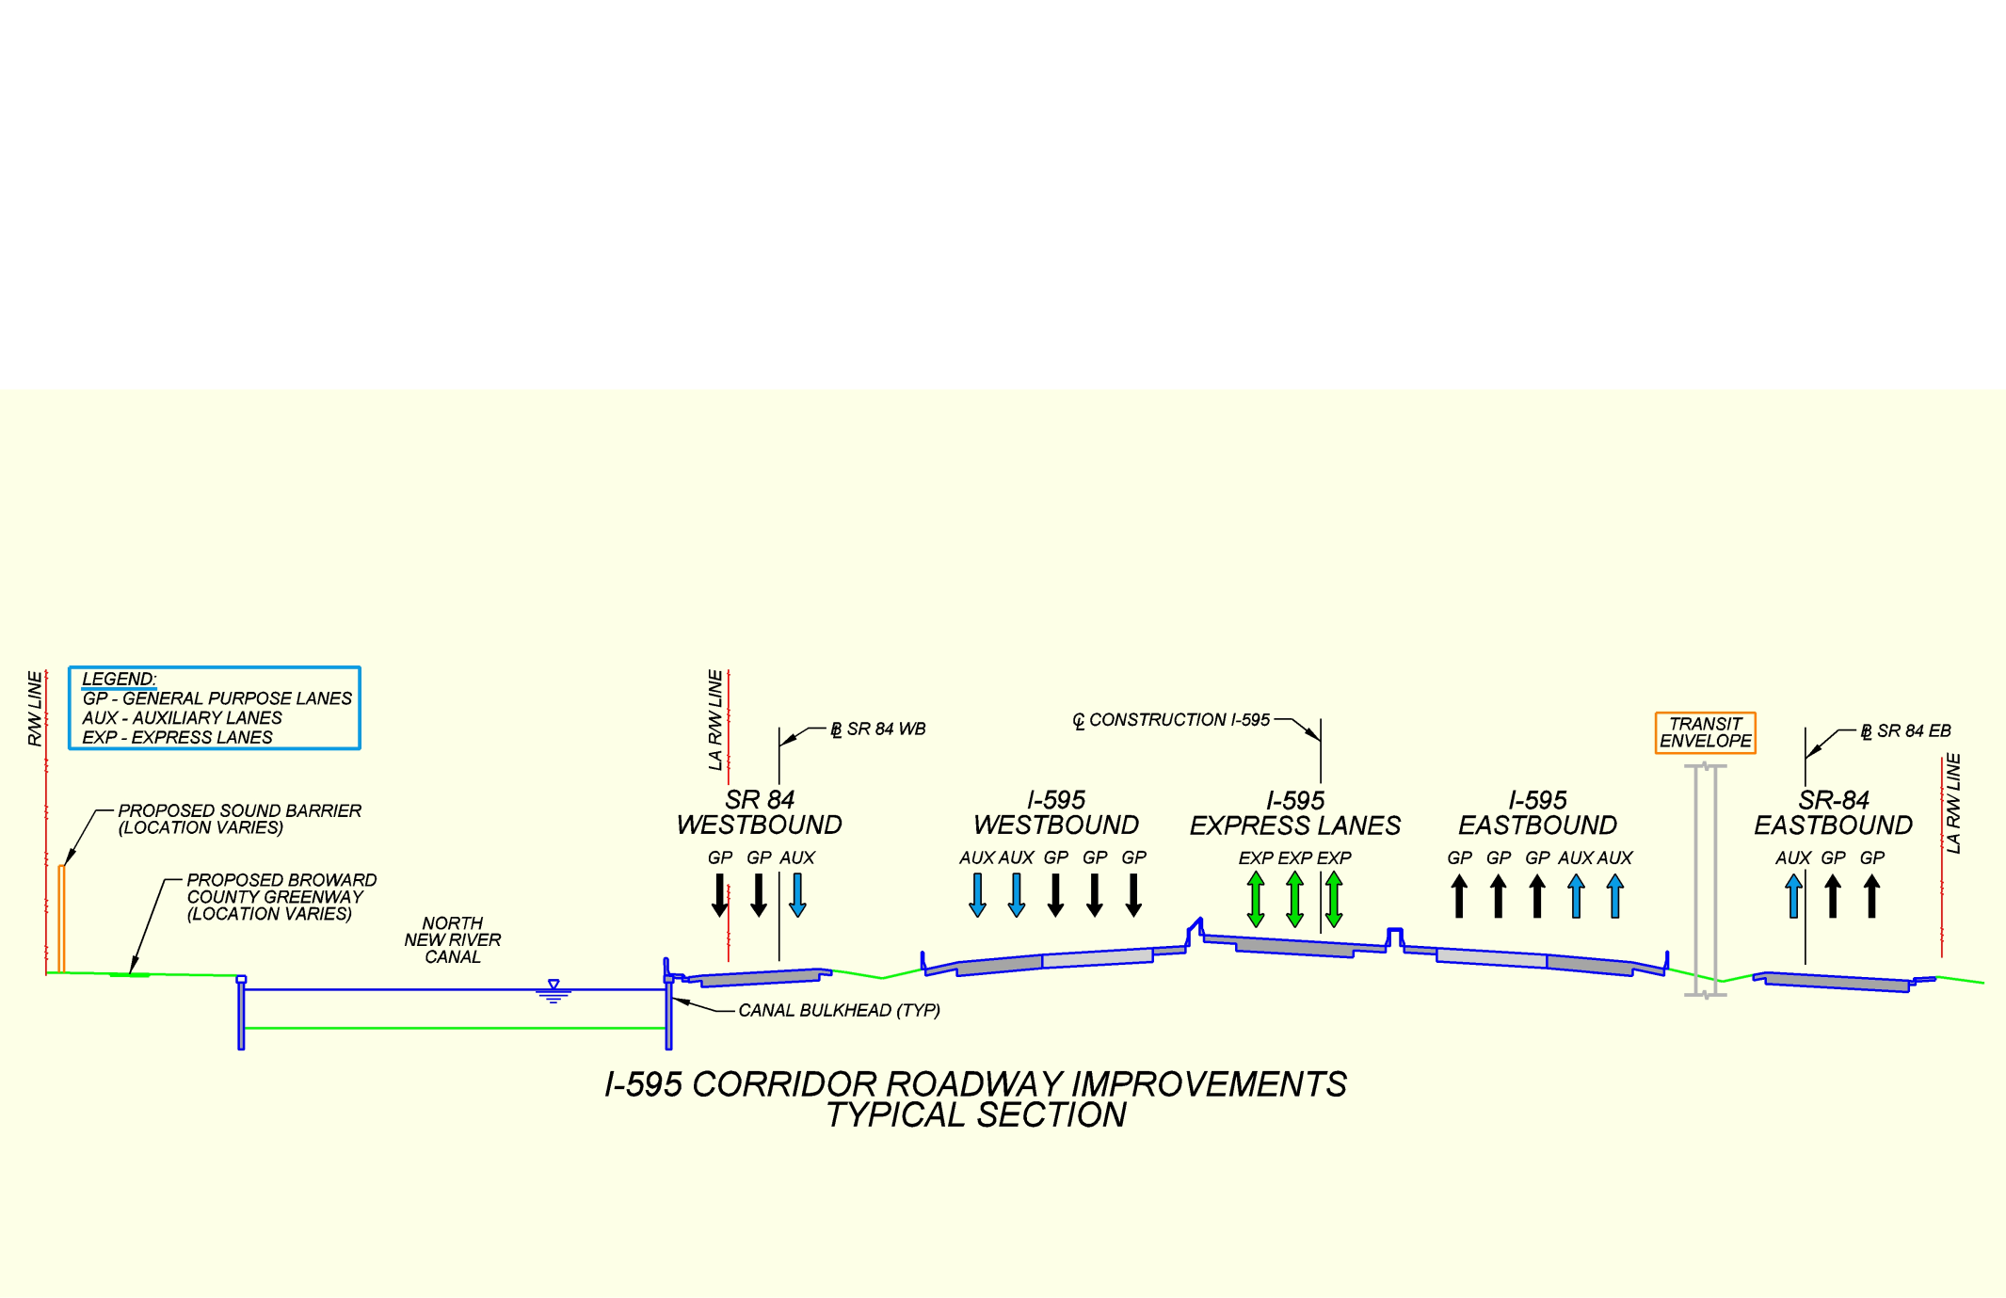
Project Components
Ramp Improvements
  Auxiliary Lanes
  Ramp Braids
  Bypass Bridges
Sound Barrier Walls
Transit Accommodations
Express Bus Service
Reversible Express Lanes
  Direct Connect to Florida’s Turnpike
  Open Road Tolling
S.R. 84 Continuous Connection
Turnpike Interchange
Broward County Greenway

Slide 7


Slide 8
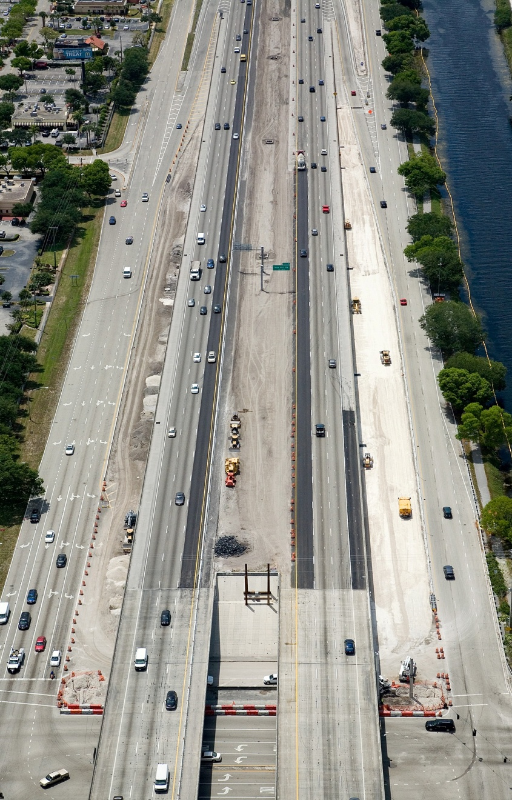
P3 Benefits
Accelerates the Schedule
  Provides capacity improvements 15 years sooner than originally planned
Provides finance mechanism for funding shortfall
No payments until project substantially complete
Potential to deliver long-term cost savings and higher levels of service
Transfer of appropriate risk items to private partner
Encourages Industry Innovation
Notes:
Note: Elaborate on Component Submittals

Slide 9
Executive Oversight
FHWA Major Projects Engineer
D4 Secretary
D4 Director of Transportation Development
D4 Director of Operations
Legal Advisory
Financial Advisory
FDOT C.O. & D4 Legal Counsel
Nossaman, Gunther, Knox & Elliott, LLP
FDOT C.O. & D4 Senior Finance Staff
Jeffrey Parker & Associates
Project Management
Technical Liaison
D4 I-595 Project Manager
D4 Construction/Operations Project Manager
FHWA
Florida’s Turnpike Enterprise
FDOT C.O. Structures
Design Management
Construction/Operations Management
Public Information
CDC Project Manager
Reynolds Smith & Hills
Oversight CEI Resident Engineer
The Corradino Group
D4 Director of Public Information
CDC Public Information Consultant
Media Relations Group
Oversight CEI Public Information
The Corradino Group
Technical Support (Construction & Operations)
Technical Support
D4 Construction Engineer
D4 Construction Compliance Officer
D4 Materials Laboratory
D4 Maintenance
D4 Traffic Operations
Oversight CEI The Corradino Group
D4 Design Engineer
D4 Structures Engineer
D4 Multi-Discipline Senior Staff
CDC Multi-Discipline Staff Consultants
Reynolds Smith & Hills

Slide 10
FDOT I-595 Consultants
Financial Services
Jeffrey A. Parker & Associates, Inc.
Design
RS&H
GBF Engineering, Inc.
URS Corporation Southern
GCME, Inc.
Signature Golf Design, Inc.
Public Information Consultant
Media Relations Group, LLC
Oversight CEI
The Corradino Group
Metric Engineering
New Millennium Engineering
Tamayo Engineering
Quest Ecology
Carnahan Proctor And Cross
Intuitive Systems
Smith Aerials
P(3)SM LLC

Slide 11









Concession Agreement
Design-Build Contractor
Concessionaire
Design-Build Contractor
DB Contract
Financing Agreements
Lenders
Technical Advisor
Design Subcontractor
Technical and Legal Advice
Counsel
CEI
O&M

Slide 12
I 595 Express, LLC Subcontractors
Administrative
CAP Engineering
Peckar and Abramson
Keith & Associates
Aerotek
Design
AECOM
Beiswenger, Hoch & Assoc., Inc.
C3TS
Curtis + Rogers Design Studio
Eptisa
F.R. Aleman & Associates, Inc.
Greenhorne & O'Mara, Inc.
Kimley-Horn and Associates
MACTEC Engineering
MPS3D
R.J. Behar & Company, Inc.
CEI
HNTB Corporation
Calvin Giordano
O&M
Jorgensen Contract Services
Florida Bushog
Procopio & Associates
Southeast Guardrail
Superior Towing
Construction
Dragados USA
Dragados-Baker
Bergeron Land Development
Alpha Corporation
Anzac
AZTEC Engineering
Beyel Brothers
Bob's Barricades
Bolton Perez & Associates
Botas Engineering Inc.
Bradshaw Construction
Brisk Construction
Brothers Concrete
C&R Painting
CECOS
Chin Diesel
Complete Highway
Duratek
Ebsary
ECM
El Champion Paint
Epperson Cranes, Inc.
Gene's Striping
Guaranteed Fence
HBC Engineering
Construction Continued
JE Hill
Johnson Davis
Kailas Contractors
Kisinger Campo & Associates
Manaty
Maytin Engineering
Nodarse and Associates
Nova Engineering and Environmental
Performance Turf
Pressure Cleaning
Resources Tech
Shoreline Foundation
Signal Group
Sorrel Development
South Florida Pile
Speedy Cutting
T&R Painting
Tate Transport
Test Lab
Transcore
US Grounds
Weekly Asphalt
Wingerter Laboratory
Currently over 90 Firms employing over 1100 staff

Slide 13
I-595 Express Project Office
10368 State Road 84
Davie, Florida 33324
www.I-595.com

Slide 14
I-595 Express Corridor Improvements Project
Rick Dun
Construction Project Manager
DRAGADOS USA

Slide 15
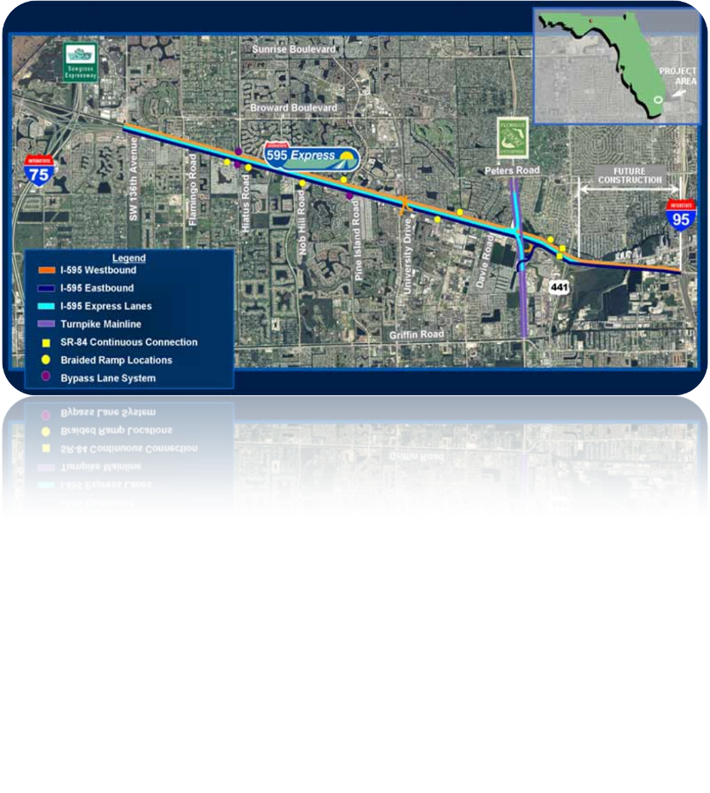
Greenway West
Greenway East
Segment E
Florida Turnpike
Segment A
Sawgrass Expressway to
Flamingo Road
Segment B
Flamingo Road to
Nob Hill Road
Segment C
Nob Hill Road to
Davie Road
Segment D
Davie Road to
I-95

Slide 16
I-595 Corridor Roadway Improvements Project
General Contracting Requirements
Dragados USA Self Performance
30%
DBE Utilization
8.1%

Slide 17
I-595 Corridor Roadway Improvements
Project Contracts in Place
All Segments Erosion Control - D. Stephenson Construction
All Segments MSE Wall - Bonn-J Contracting
All Segments Pavement Markings - Gene’s Striping
All Segment Sound Barrier Walls – Duratek Precast Technologies
Sound Barrier Class V Finish - Zarnas
Segment C Roadway, Drainage, Concrete - Bergeron Land Development
Segment C Bulkhead - Ebsary Foundation
Segment C Micro-tunneling - Bradshaw Construction
Segment D Roadway, Drainage, Concrete - Ranger Construction
Segment D Signs and Signals - Southeast Underground Utilities
Segement D Guardrail – Guaranteed Fence
Various Bridges – GLF Construction, Dragados-Baker Joint Venture, Zep Construction
Supply - Concrete, Steel Girders, Piling, Prestressed Beams, Sheet Piling

Slide 18
Greenway West
Work commenced June 2009
Expected completion June 2010
Contracts to be Let - None
Greenway East
Work commenced April 2010
Expected completion November 2010
Contracts to be Let - Asphalt Paving
    Landscaping, Sod

Slide 19
Segment C (Nob Hill Road to Davie Road)
Work commenced February 2010
Expected completion July 2013
Contractors - Bergeron Land Development
Bonn-J Contracting
Bradshaw Construction
Dragados-Baker Joint Venture
Duratek
Ebsary Foundation
Gene’s Striping
GLF Construction
Contracts to be Let - Friction Course
  Rumble Strips
  Landscaping, Sod
  ITS Infrastructure
  Various Utility Relocations
  Bridges (6)

Slide 20
Segment D (Davie Road to I-95)
Work to commence June 2010
Expected completion October 2013
Contractors – Ranger Construction
Southeast Underground Utilities
Guaranteed Fence
Bonn-J Contracting
Gene’s Striping
GLF Construction
Dragados-Baker Joint Venture
Contracts to be Let - Friction Course
Bulkhead
  Rumble Strips
  Landscaping, Sod
  ITS Infrastructure
  Various Utility Relocations
  Bridges (5)

Slide 21
Segment E (Florida Turnpike)
Work to commence 3rd Quarter 2010
Expected completion November 2013
Contractors – Bonn-J Contracting
Duratek
Gene’s Striping
GLF Construction
Contracts to be Let
Roadway
Drainage
Concrete Work
Signs
Guardrail
Lighting
ITS Infrastructure
Various Utility Relocations
Friction Course
Landscaping, Sod
Bridges (1)

Slide 22
Segment A (Sawgrass Expressway to Flamingo Road)
Segment B (Flamingo Road to Nob Hill Road
Work to commence 3rd Quarter 2010
Expected completion August 2013
Contractors – GLF Construction
  Bonn-J Contracting
Dragados-Baker Joint Venture
Duratek
Contracts to be Let – Roadway
Drainage
Concrete Work
Signs
Signalization
Guardrail
Lighting
ITS Infrastructure
Various Utility Relocations
Friction Course
Landscaping, Sod
Bridges (5)

Slide 23
I-595 Express Corridor Improvements Project
Isa Carreras
Human Resource Manager
DRAGADOS USA

Slide 24
I-595 Express Corridor Improvements Project
Sylvia Blackmon-Roberts
President / CEO
Lee Thomas
Blackmon Roberts Group, Inc.

Slide 25
I-595 Express Project Office
10368 State Road 84
Davie, Florida 33324
Project Info
www.I-595.com
Vendor Registration
www.i595express.com

Slide 26
THANK YOU
FOR COMING!
EXPO HALL
Open until 10:00 a.m.

